Slide 1

SJSU Spring 2020 EE122 lab section #5 lab 4
Energy Harvesting PCB Design
No lab report due, but Diptrace files needs to be submitted
Check your design with your TA before you leave
TA: Wen Zhi Qian
Email: wenzhi.qian@sjsu.edu

Slide 2
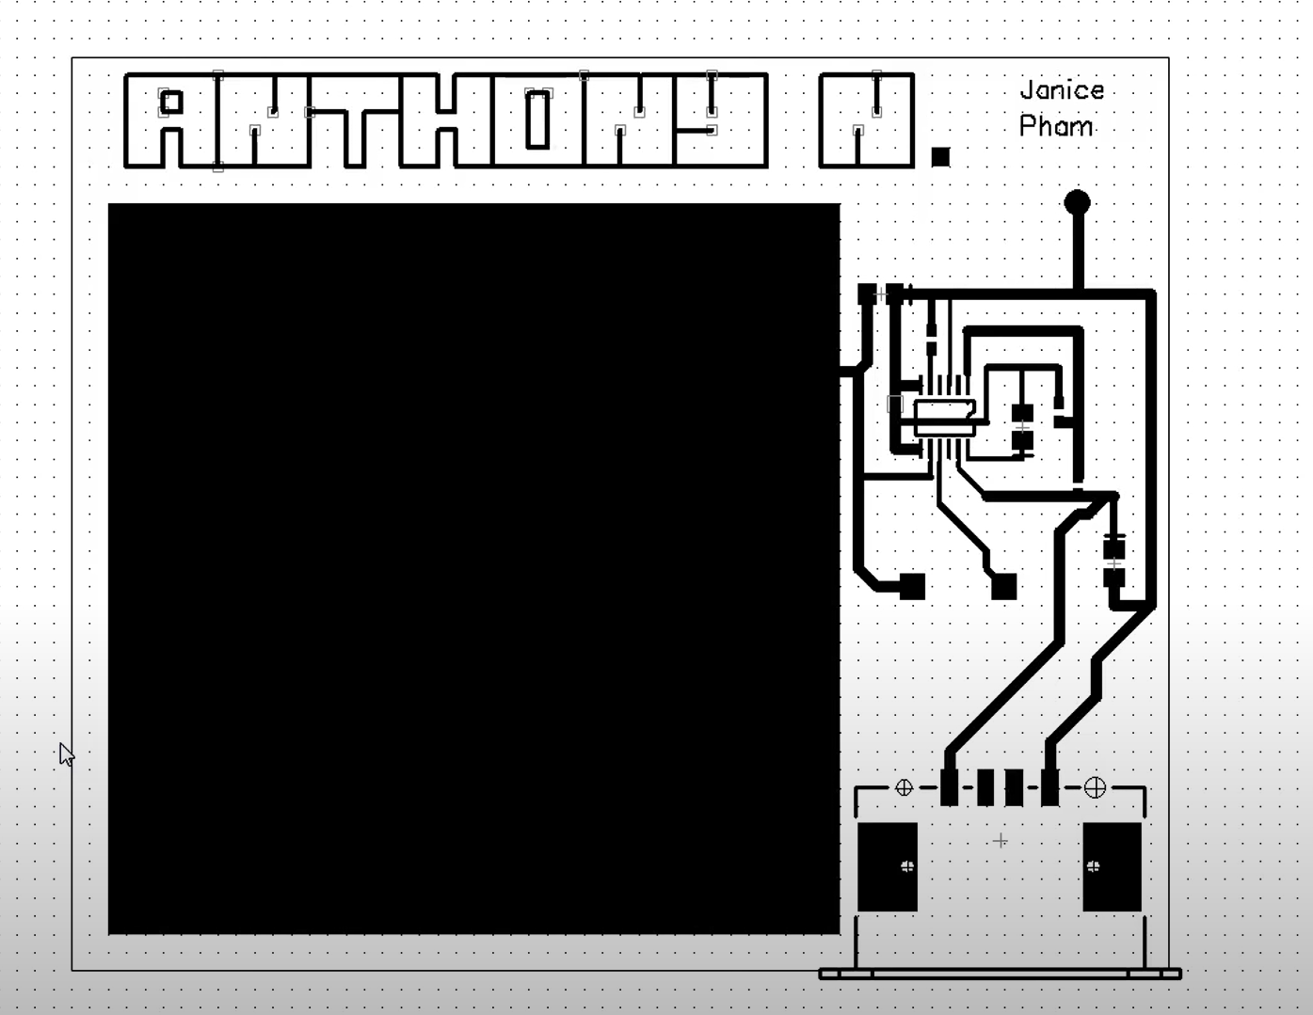
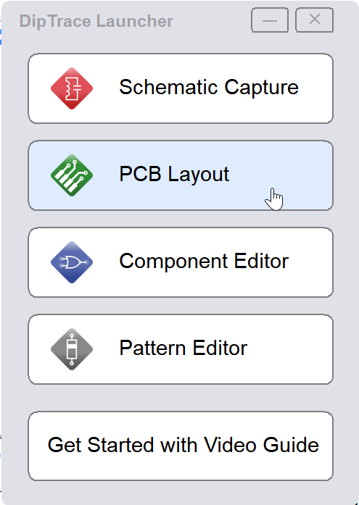
GND
Use PCB layout might be easier for making this

Slide 3
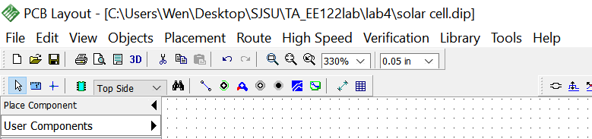
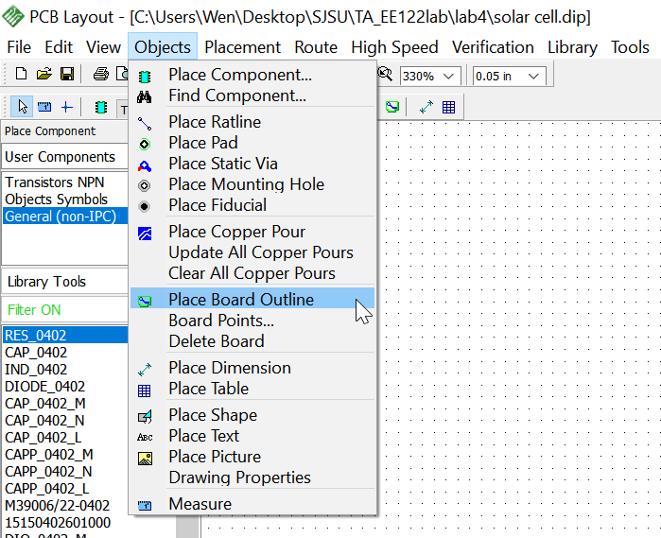
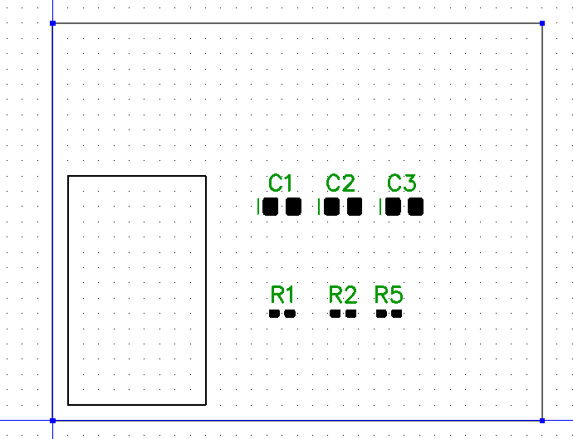
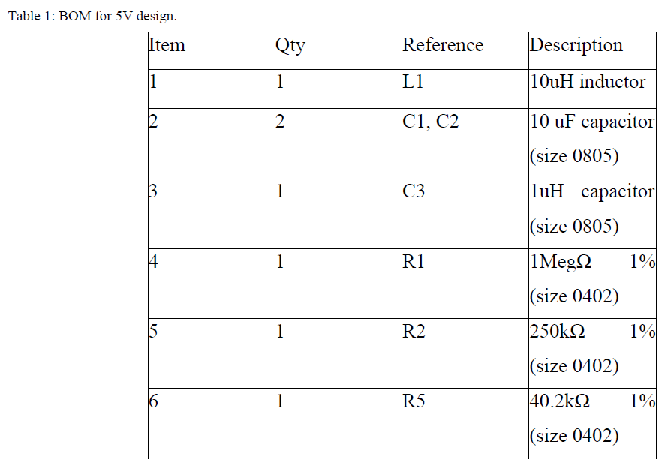
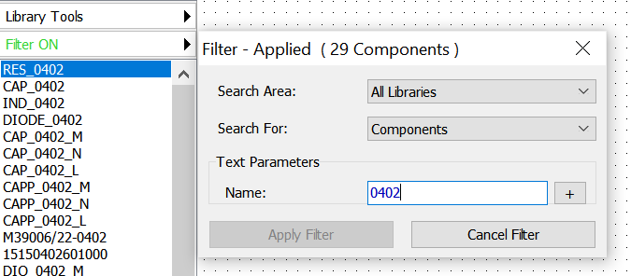
Step 3. Place copper pour
Step 2. Place board outline
or
Make sure search in all libraries
Step 1. Place all needed 3x capacitors (search 0805 in all libraries) and 3x resistors (search 0402 in all libraries).

Slide 4
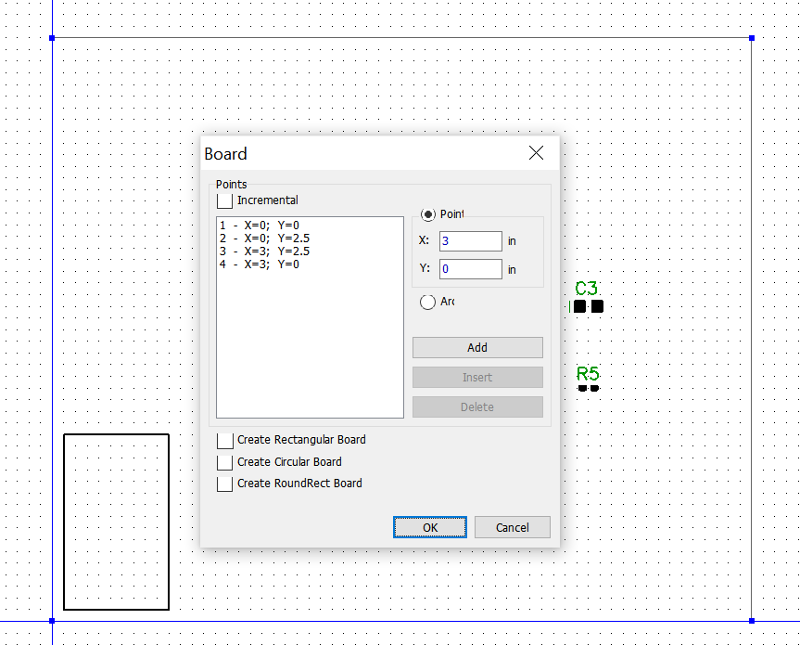
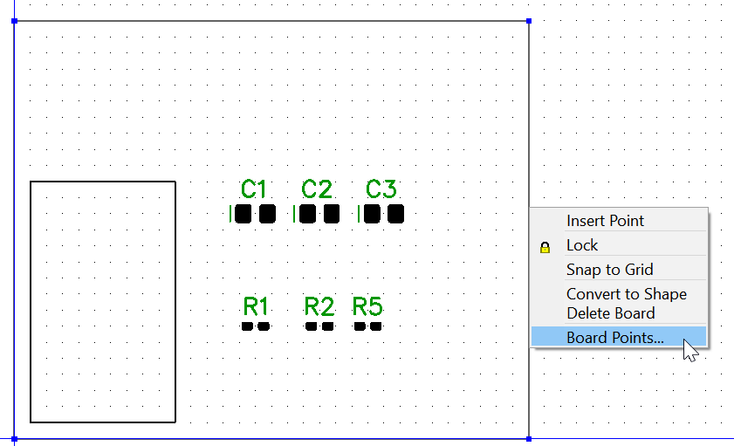
Change the board outline size to 3’’ x 2.5”

Slide 5
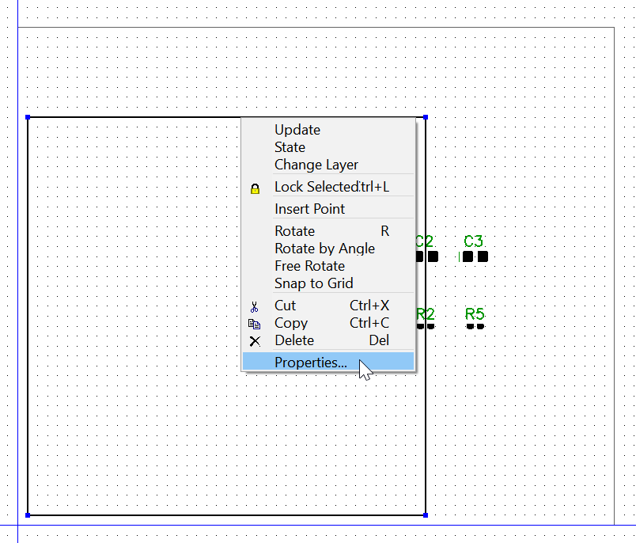
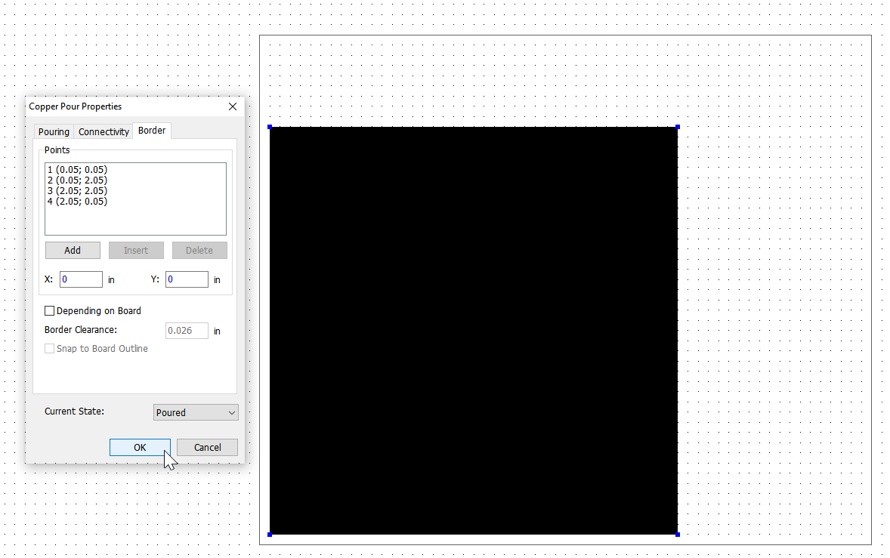
Change the copper pour size to 2” x 2”

Slide 6
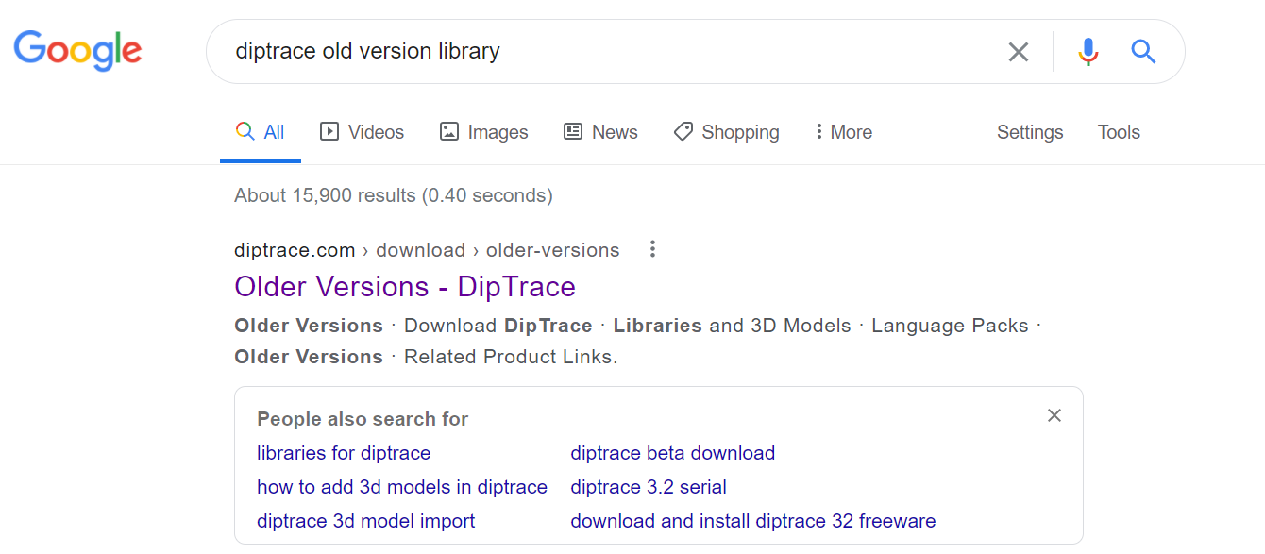
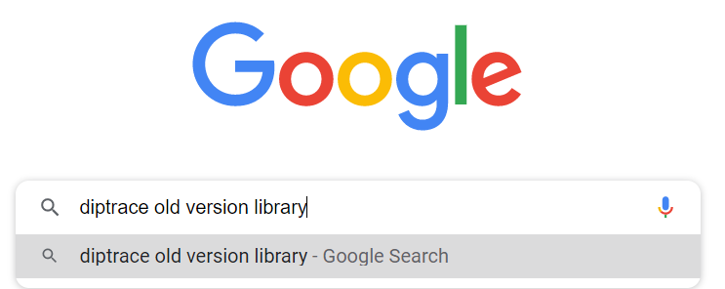
Note: This USB might not be in your new version of Diptrace library. You will need to download the old version library if that is the case.
Here is the tutorial for downloading old version library.

Slide 7
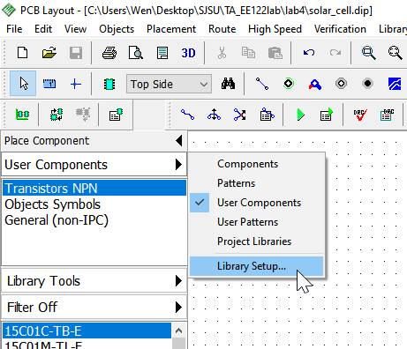
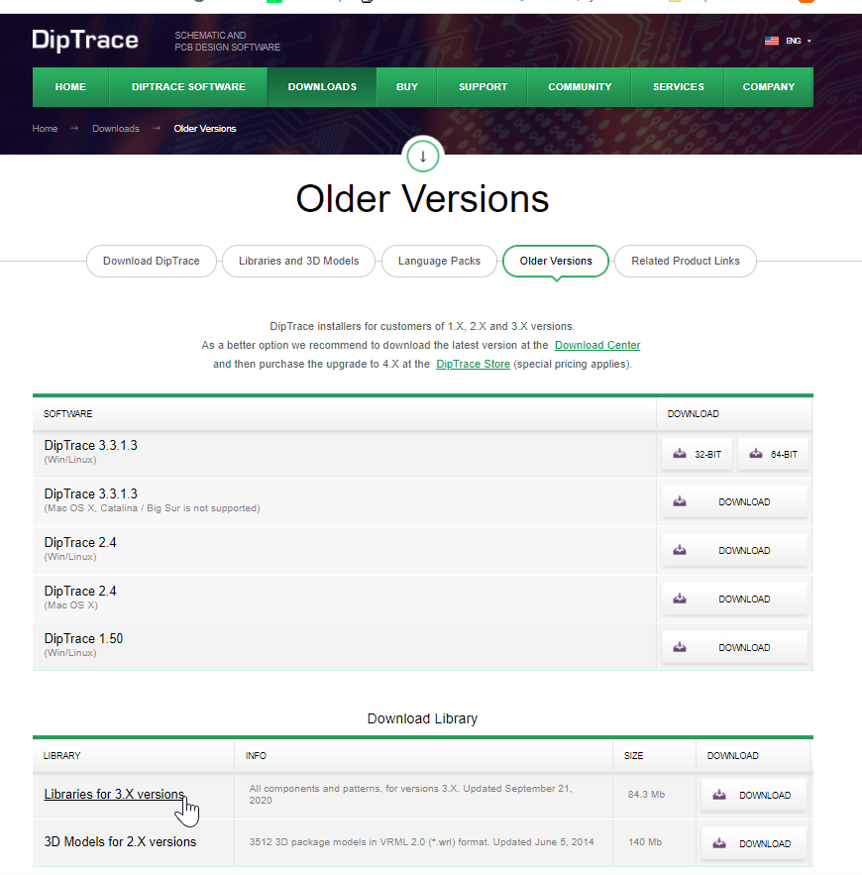
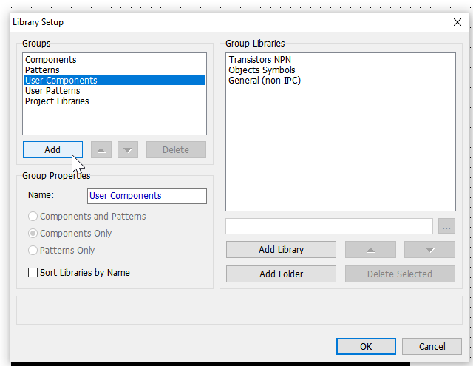
https://diptrace.com/download/older-versions/
Download to your computer and unzip it
Click Add

Slide 8
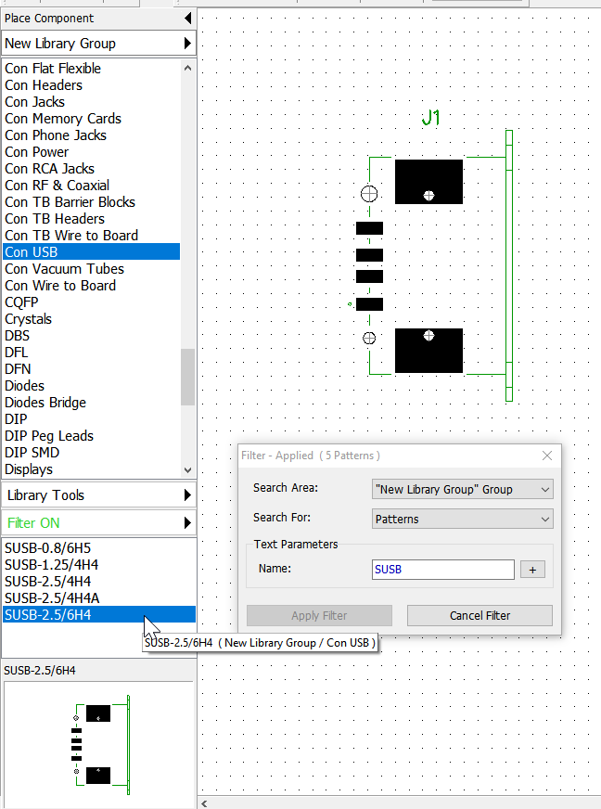
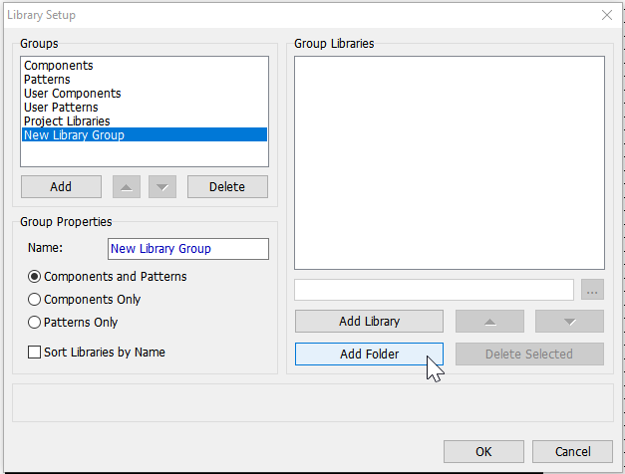
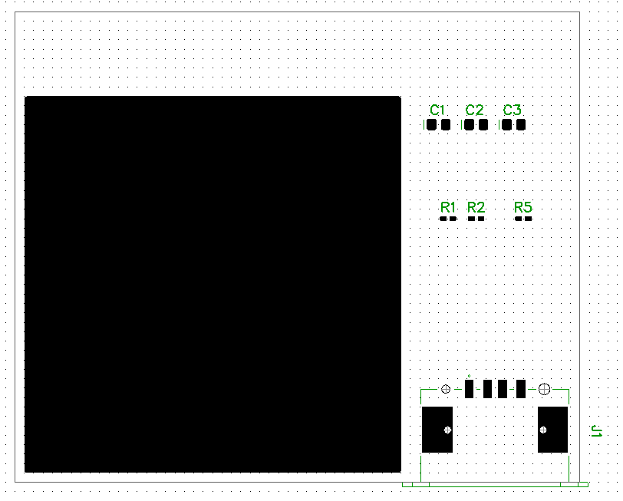
Add the directory of your unzipped folder, click ok
Position it

Slide 9
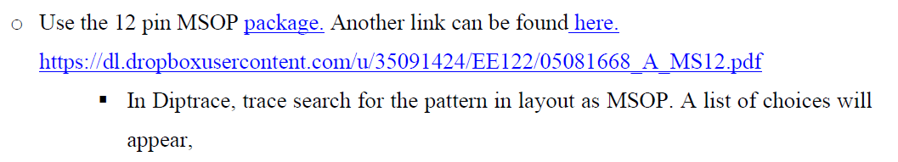
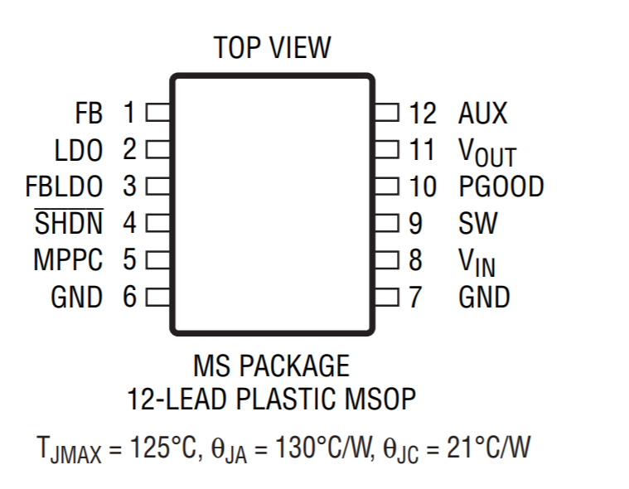
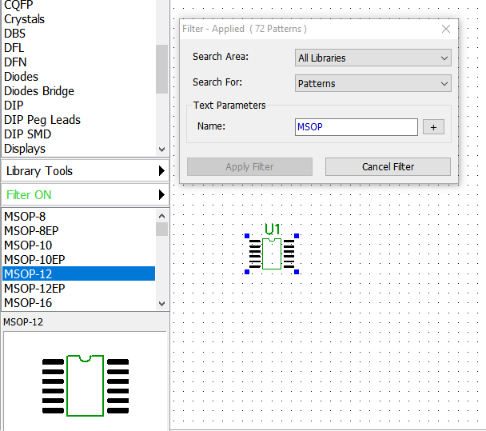
LTC3105 pin configuration
Reference web:
https://www.analog.com/media/en/technical-documentation/data-sheets/3105fb.pdf （page#2）

Slide 10
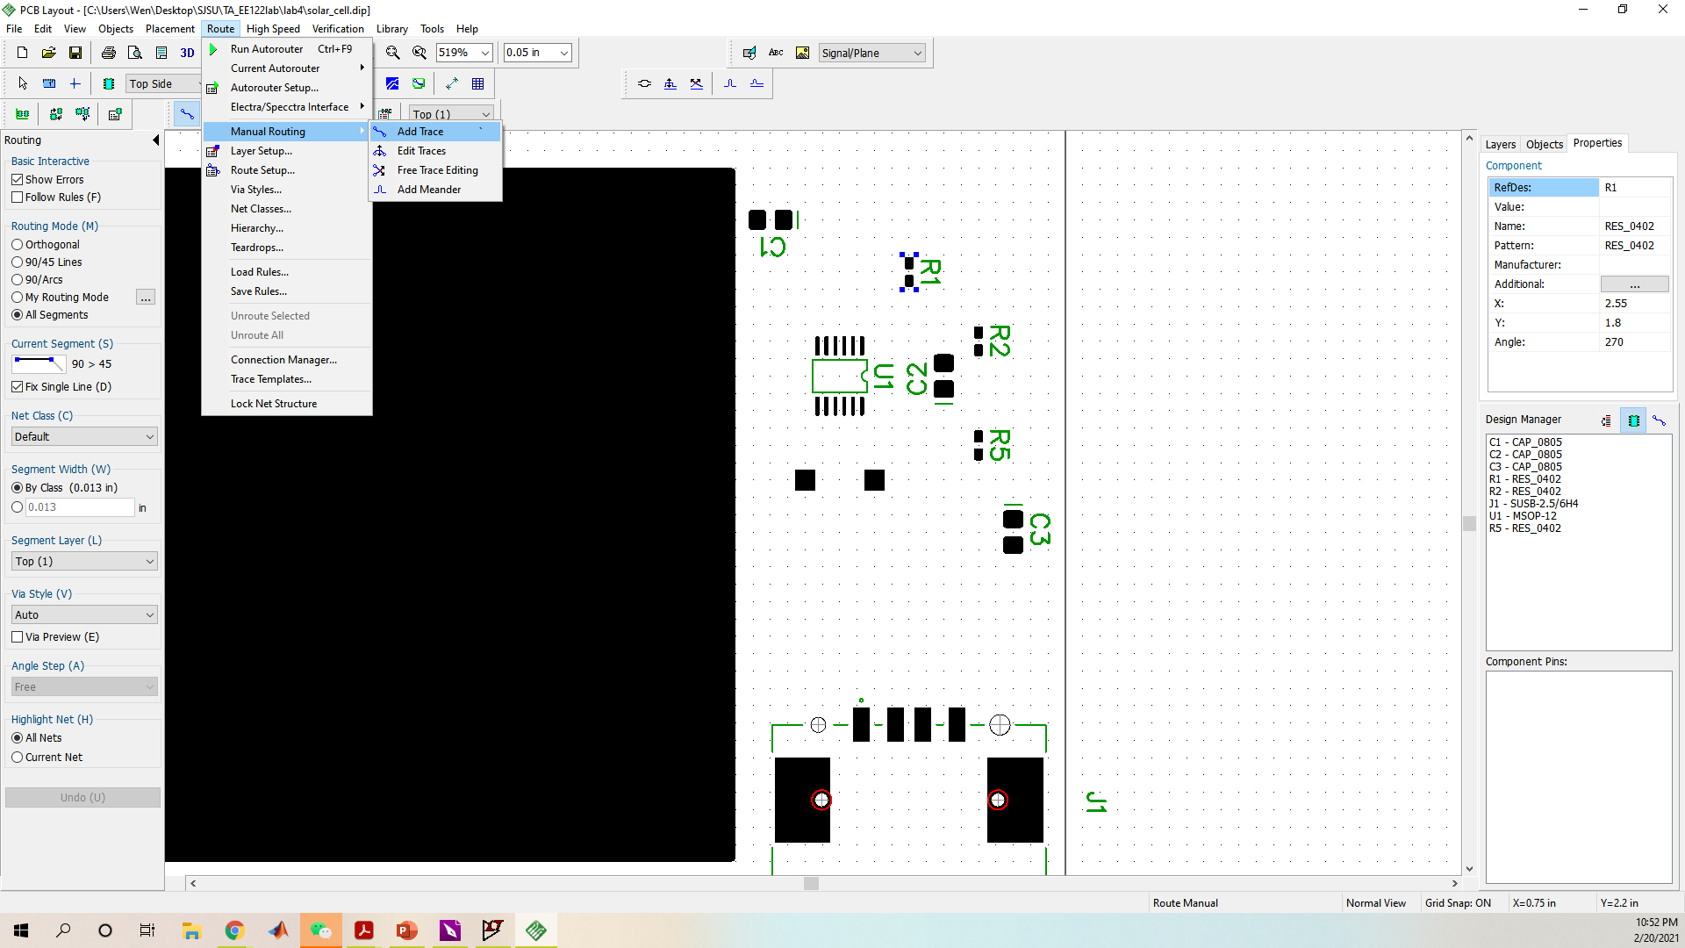
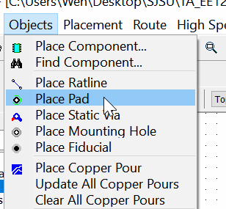
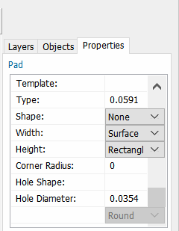
Choose manual routing
On right change properties
+

Slide 11
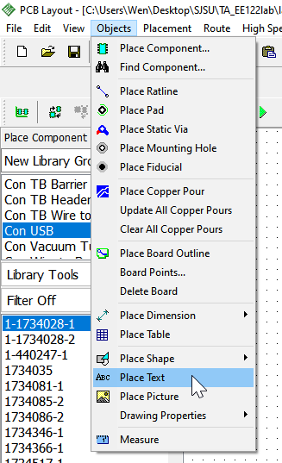
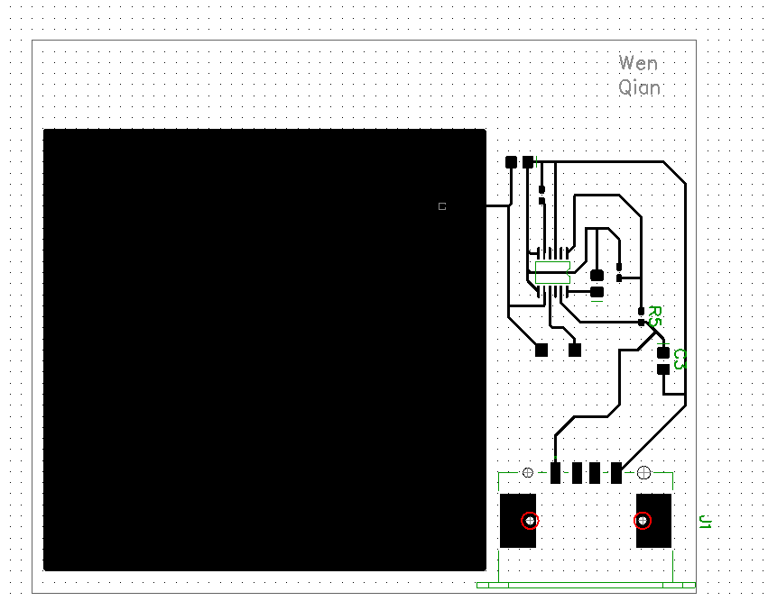
Place your name on the design
Method #1

Slide 12
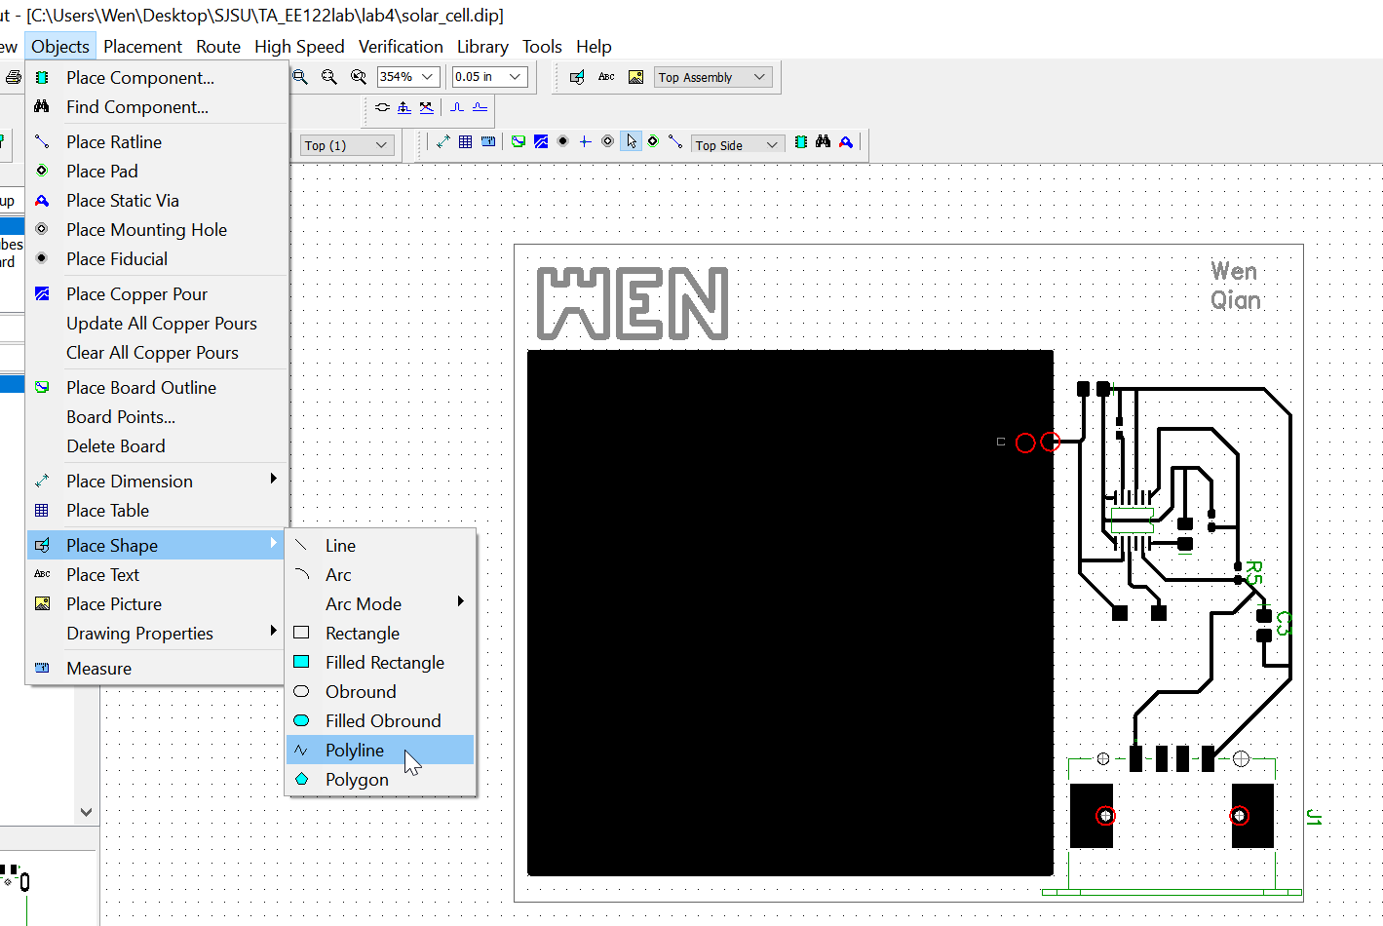
Place your name on the design
Method #2

Slide 13
The END

